Slide 1
Evolutionary cause of phylogenetic diversity between East Asian and East North American disjunct forest communities
Miao Sun, Hanyang Lin
July 02, 2019

Slide 2
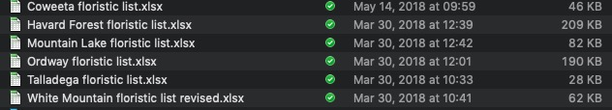
Species list
Too less compared with Chinese list

Slide 3
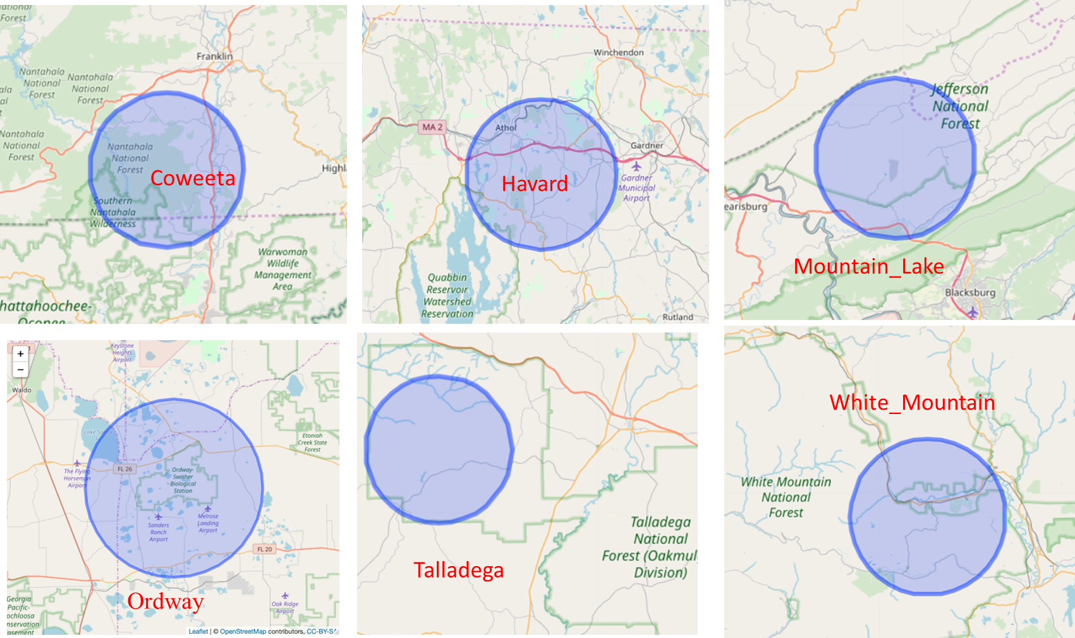
Centered coordinated of each site
Seed plant accepted names
IDigBio + GBIF + old_species_list

Slide 4
Adding in more species

Slide 5
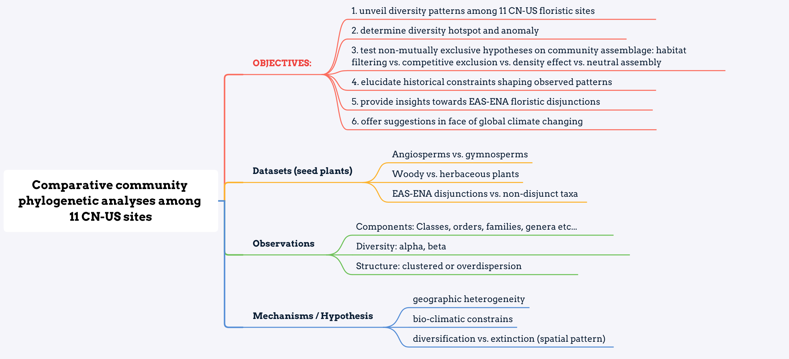
Manuscript structure
Notes:
conception of anomaly and analysis
NRI 和 NTI 极性不同时 应该倾向于哪一个结果
to do: more bio-climatic factors
群落年龄对于群落结构的影响 检索文献 2013 PNAS
对于不同的组分产生的PD进行PCA
对于beta PD，可以解决什么样的科学问题

Slide 6
Questions:
Which floristic region, i.e., EA or ENA, harbors greater species diversity, including species richness (SR) and phylogenetic diversity (PD)?
Among 11 EAS-ENA sites, where is PD hotspot among US-CN 11 sites? Following any patterns (Latitude, lifeform, disjunct)?
How angiosperms vs. gymnosperms, woody vs. herbaceous, or EA-ENA disjunction vs Non- disjunction contribute to PD (α & β) of EA and ENA forest communities?
Insights for community structure and community assemblage process at regional and local scale, respectively?

Slide 7
Q1: Which floristic region harbors greater species diversity, including species richness (SR) and phylogenetic diversity (PD)?

Slide 8
Species richness (SR)
CN > US; Shengnong (CN); Harvard (US)
Notes:
CN has higher SR

Slide 9
Categories | ntaxa | PD | SES-PD | NRI | NTI
CN | 3667 | 66034.38 | -2.71 | -0.58 | 2.08
US | 2194 | 44617.83 | -6.40 | 1.28 | 4.94
CN > US
Notes:
EA sites show greater species diversity than ENA. In term of species richness, sites in EA harbor over one and half times of species number as ENA sites do (3667 vs. 2194). Meanwhile, both observed and standard-effective-size (SES) PD are determined to be greater in EAS sites than ENA (observed PD: 66034.38 vs. 44617.83, SES-PD: -2.71 vs. -6.40).
number of gym is too small
NRI与wood相悖

Slide 10
Q2: Among 11 EAS-ENA sites, where is PD hotspot among US-CN 11 sites? Following any patterns (Latitude, lifeform, disjunct)?

Slide 11
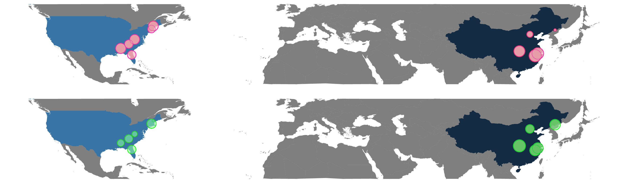
α PD --- US-CN 11 sites
SES-PD
SR
CN sites decrease along latitude
Changbai, and White Mountain (SR vs. PD)

Slide 12
Over all Gutian is hotspot; Talladega is hotspot in US
Notes:
有没有必要比较s和t的区别。

Slide 13
Site | Area (km²) | Elevation-max (m) | MAT (℃) | MAP (mm) | ntaxa | SD | SES-PDt | NRIt | NTIt
Changbai | 1907.81 | 2744 | 2.13 | 741 | 1140 | 150.92 | -8.92 | 1.10 | 5.50
Dongling | 60.00 | 2303 | 7.11 | 493 | 773 | 188.80 | -7.58 | -0.41 | 5.81
Shennong | 704.67 | 3106 | 12.94 | 1156 | 1559 | 237.73 | -1.57 | -0.80 | 2.44
Tianmu | 43 | 1505 | 12.92 | 1487 | 1188 | 315.86 | -0.63 | 0.80 | 1.90
Gutian | 81.07 | 1258 | 15.91 | 1963.7 | 1209 | 275.07 | 0.56 | -0.89 | 0.17
White_Mountain | 15.66 | 232 | 4.8 | 1300 | 254 | 92.33 | -3.49 | -2.64 | 2.79
Havard | 49.00 | 351 | 7.2 | 1120 | 897 | 230.48 | -6.34 | -0.35 | 4.82
Mountain_Lake | 12.60 | 1160 | 9.8 | 1045 | 381 | 150.37 | -3.61 | -0.69 | 3.60
Coweeta | 16.26 | 914 | 11.9 | 1754 | 681 | 244.20 | -5.35 | 2.05 | 4.18
Talladega | 53.00 | 135 | 17.1 | 1425 | 533 | 134.25 | -2.89 | 1.17 | 1.94
Ordway | 38.44 | 45 | 20.3 | 1313 | 749 | 205.26 | -5.23 | 1.41 | 4.28
Correlation with env. Variables (small size: 11)
Notes:
放到最后

Slide 14
Q3: How angiosperms vs. gymnosperms, woody vs. herbaceous, or EA-ENA disjunction vs Non- disjunction contribute to PD (α & β) of EA and ENA forest communities?
Notes:
woody vs. herbaceous α & β pd

Slide 16
Latest compilation: 75 genera ( 25 woody, 50 herbaceous)
Site | Disjunct genera | Disjunct Species | Non-disjunct Species
CN | 61 | 263 | 3404
US | 62 | 145 | 2049
Total | 70 | 395 | 5213
No-disjunct > Disjunct; US opposite pattern

Slide 17
Community phylogeny -β diversity
Phylogenetic community dissimilarity (PCD): pairwise differences between communities
PCDc: a nonphylogenetic component that reflects nonshared species between communities
PCDp: a phylogenetic component that reflects the evolutionary relationships among nonshared species
UniFrac: a phylogenetic beta diversity metric of the unique (non-shared) fraction of total phylogenetic diversity (branch-length) between two communities.
PCD is partitioned into a nonphylogenetic component that reflects shared species between communities (PCDc) and a phylogenetic component that reflects the evolutionary relationships among nonshared species (PCDp)

Slide 18
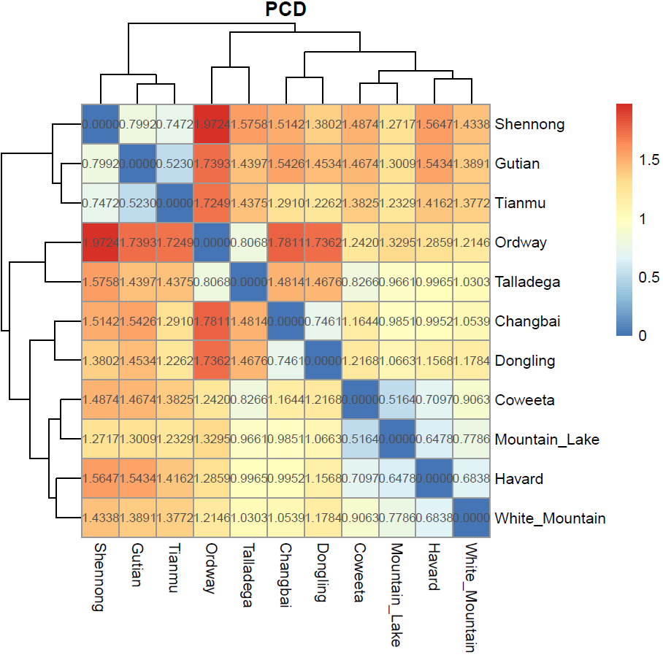
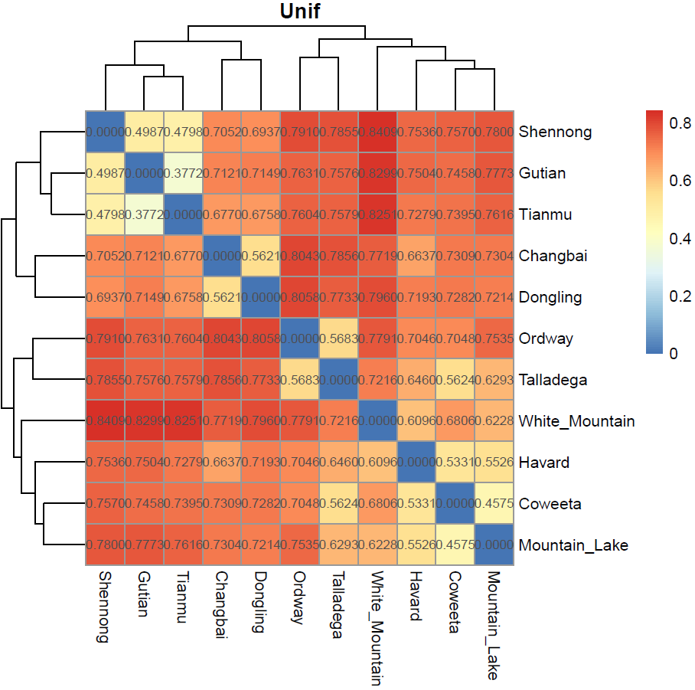
US-CN 11 Sites-β diversity
White Mountain vs. Shengnong, most CN sites
Coweeta= Talladega
Gutian=Tianmu
Changbai vs. most CN south
Ordway vs. Shengnong, and most CN sites
Ordway= Talladega
Coweeta=Moutain_Lake
Gutian=Tianmu
Changbai vs. most CN south

Slide 19
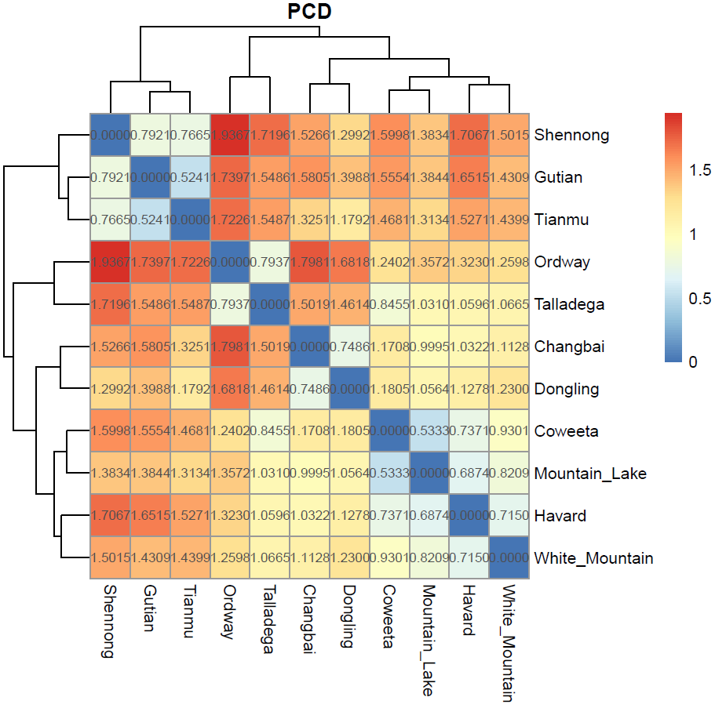
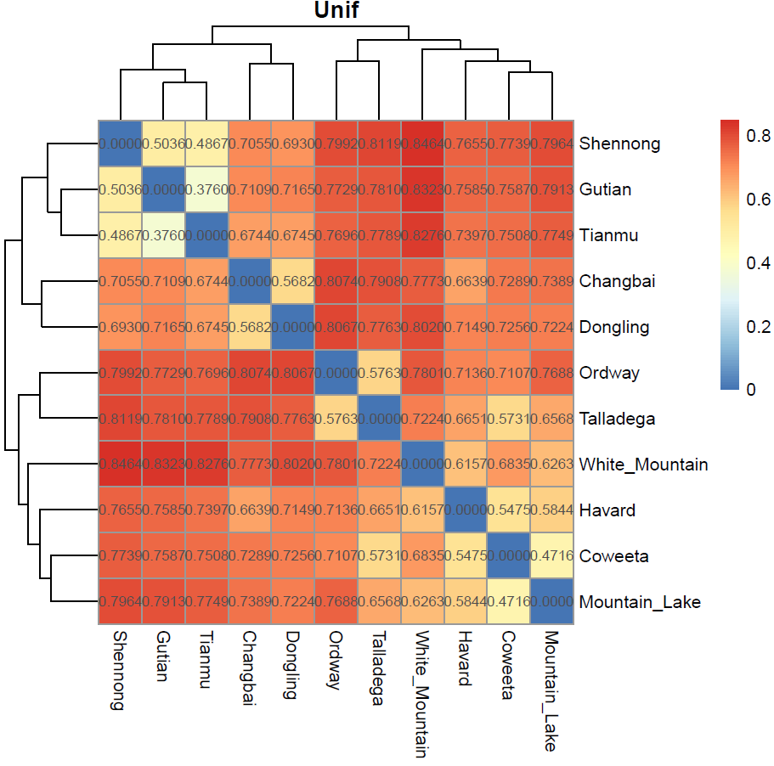
Disjunct only -β diversity
White Mountain vs. Shengnong
Gutian=Tianmu
Ordway vs. Shengnong
Gutian=Tianmu

Slide 20
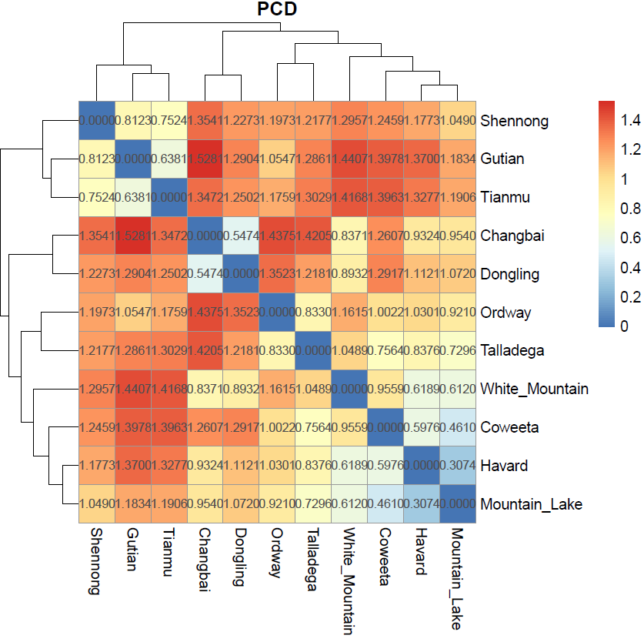
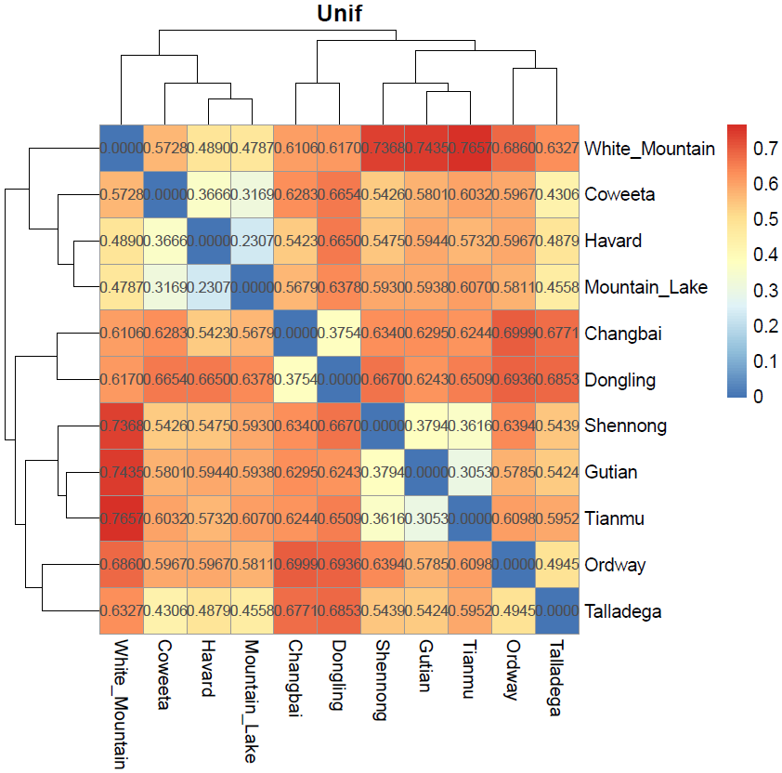
No-Disjunct -β diversity
Harvard=Mountain
Shenong vs. White Moutian
White Mountain = Harvard
Gutian vs. Changbai

Slide 21
Q4: Insights for community structure and community assemblage process at regional and local scale, respectively?

Slide 22
Categories | ntaxa | PD | SES-PD | NRI | NTI
CN | 3667 | 66034.38 | -2.71 | -0.58 | 2.08
US | 2194 | 44617.83 | -6.40 | 1.28 | 4.94
Woody | 1845 | 38071.57 | -9.12 | -8.43 | 5.31
Herb | 3743 | 55541.59 | -22.04 | 16.08 | 12.36
Angiosperms | 5532 | 86493.48 | -12.26 | 72.62 | 3.43
Gymnosperms | 76 | 2389.24 | -8.91 | 4.46 | 7.80
Red: significant over-dispersion
Green: significant clustering
Overall clustering; Woody over-dispersion
Notes:
EA sites show greater species diversity than ENA. In term of species richness, sites in EA harbor over one and half times of species number as ENA sites do (3667 vs. 2194). Meanwhile, both observed and standard-effective-size (SES) PD are determined to be greater in EAS sites than ENA (observed PD: 66034.38 vs. 44617.83, SES-PD: -2.71 vs. -6.40).
number of gym is too small
NRI与wood相悖

Slide 23
Country | Site | ntaxa | SES-PDt | NRIt | NTIt
CN | Changbai | 1140 | -8.92 | 1.10 | 5.50
CN | Dongling | 773 | -7.58 | -0.41 | 5.81
CN | Shennong | 1559 | -1.57 | -0.80 | 2.44
CN | Tianmu | 1188 | -0.63 | 0.80 | 1.90
CN | Gutian | 1209 | 0.56 | -0.89 | 0.17
US | White_Mountain | 254 | -3.49 | -2.64 | 2.79
US | Havard | 897 | -6.34 | -0.35 | 4.82
US | Mountain_Lake | 381 | -3.61 | -0.69 | 3.60
US | Coweeta | 681 | -5.35 | 2.05 | 4.18
US | Talladega | 533 | -2.89 | 1.17 | 1.94
US | Ordway | 749 | -5.23 | 1.41 | 4.28
Red: significant over-dispersion
Green: significant clustering
Overall clustering; White Mountain over-dispersion

Slide 24
Category | ntaxa | PD | SES-PD | NRI | NTI
CN | 3667 | 66034.38 | -2.71 | -0.58 | 2.08
US | 2194 | 44617.83 | -6.40 | 1.28 | 4.94
Disjunct-total | 395 | 9451.63 | -14.68 | -6.41 | 12.55
Nondisjunct-total | 5213 | 83492.60 | -4.25 | 10.08 | 0.47
Disjunct-CN | 263 | 7649.42 | -12.46 | -2.03 | 9.68
Nondisjunct-CN | 3404 | 62029.77 | -4.32 | 4.99 | 0.98
Disjunct-US | 145 | 6595.21 | -4.21 | -6.82 | 4.76
Nondisjunct-US | 2049 | 40850.76 | -9.51 | 9.43 | 5.42
Red: significant over-dispersion
Green: significant clustering
Overall clustering; Disjunct taxa over-dispersion
Notes:
Which value should be decisive?

Slide 25
Genus level phylogeny with Target Enrichment data
353 nuclear genes
130 (Soltis) + 150 (ZYP) +
96 (Jenney) + CZD (86)
Miao Sun
July 02, 2019

Slide 26
workflow
FastQC
Trimmomatic
HybPiper
Mafft
Phyx
RAxML
Github (https://github.com/Cactusolo/IESHTSTE)

Slide 27
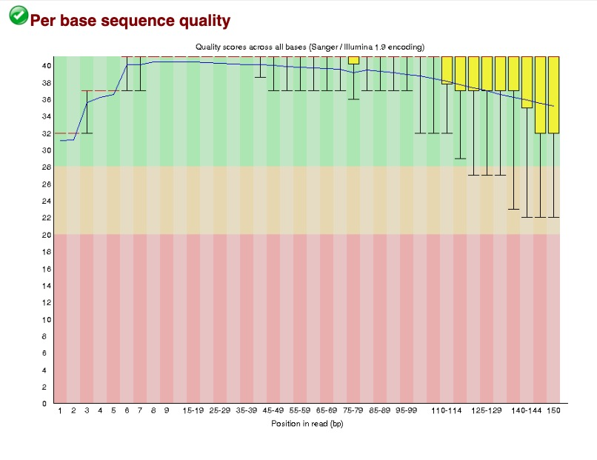
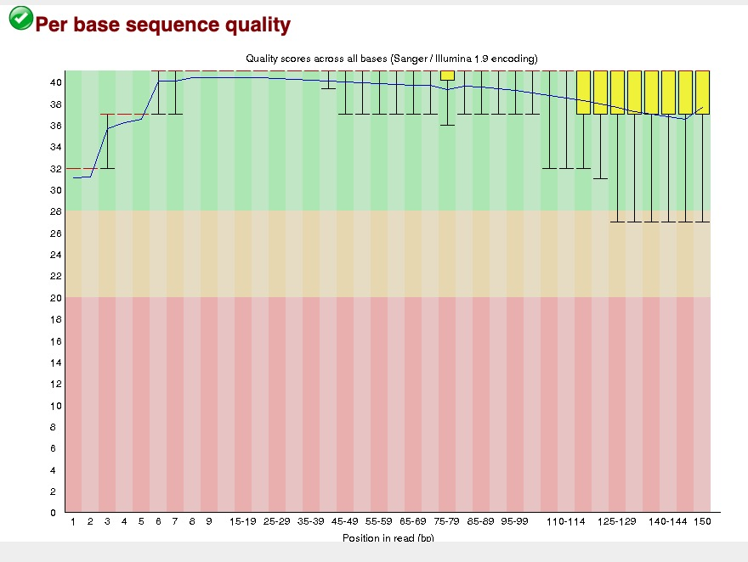
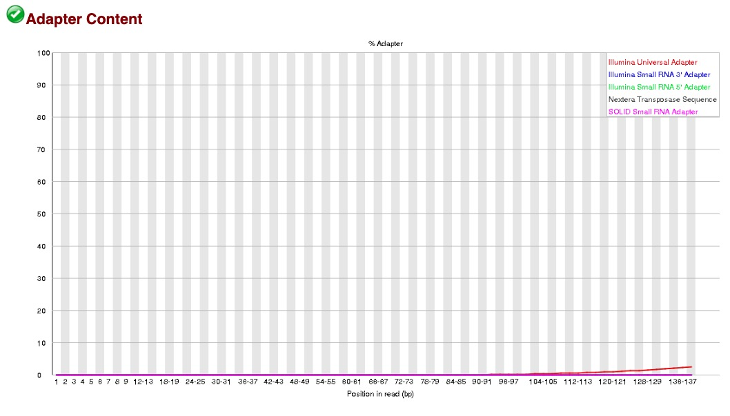
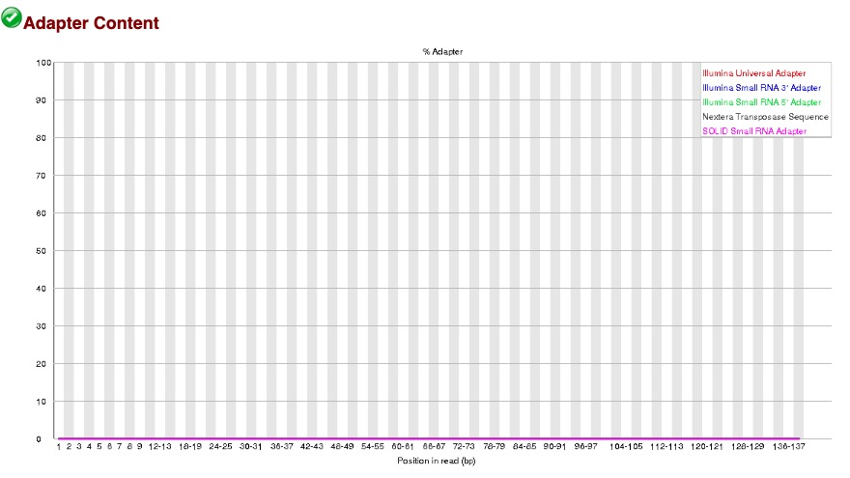
FastQC & Trimmomatic SLIDINGWINDOW:20:20

Slide 28
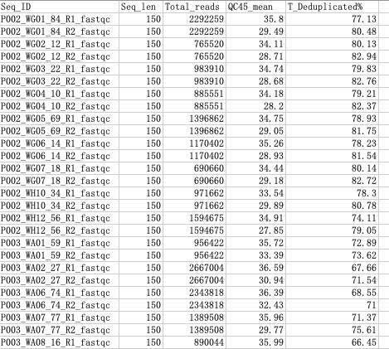
FastQC

Slide 29
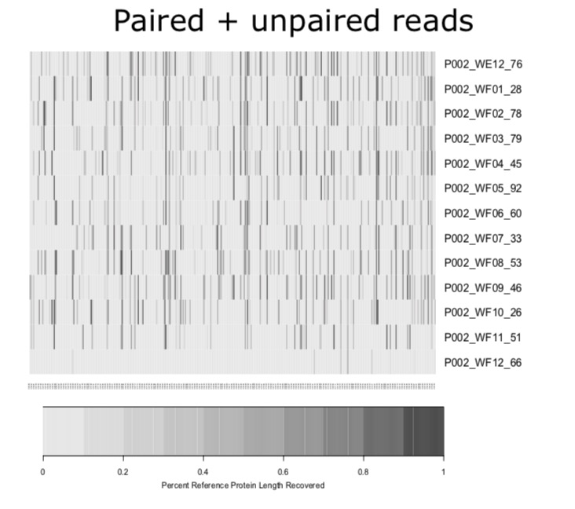
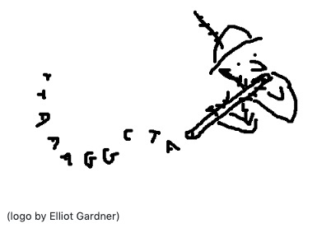
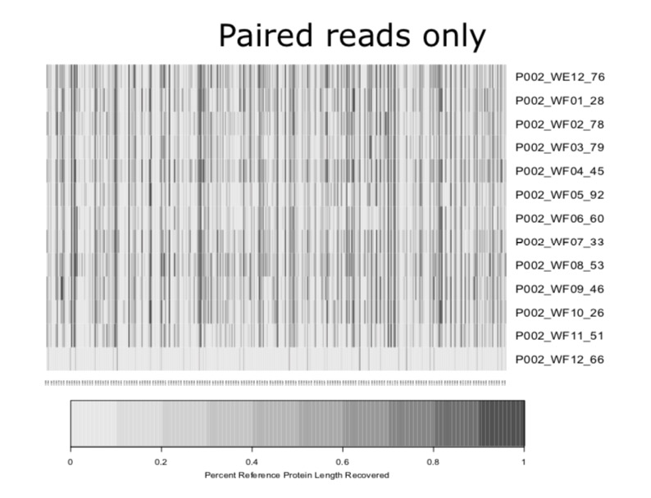
HybPiper

Slide 30
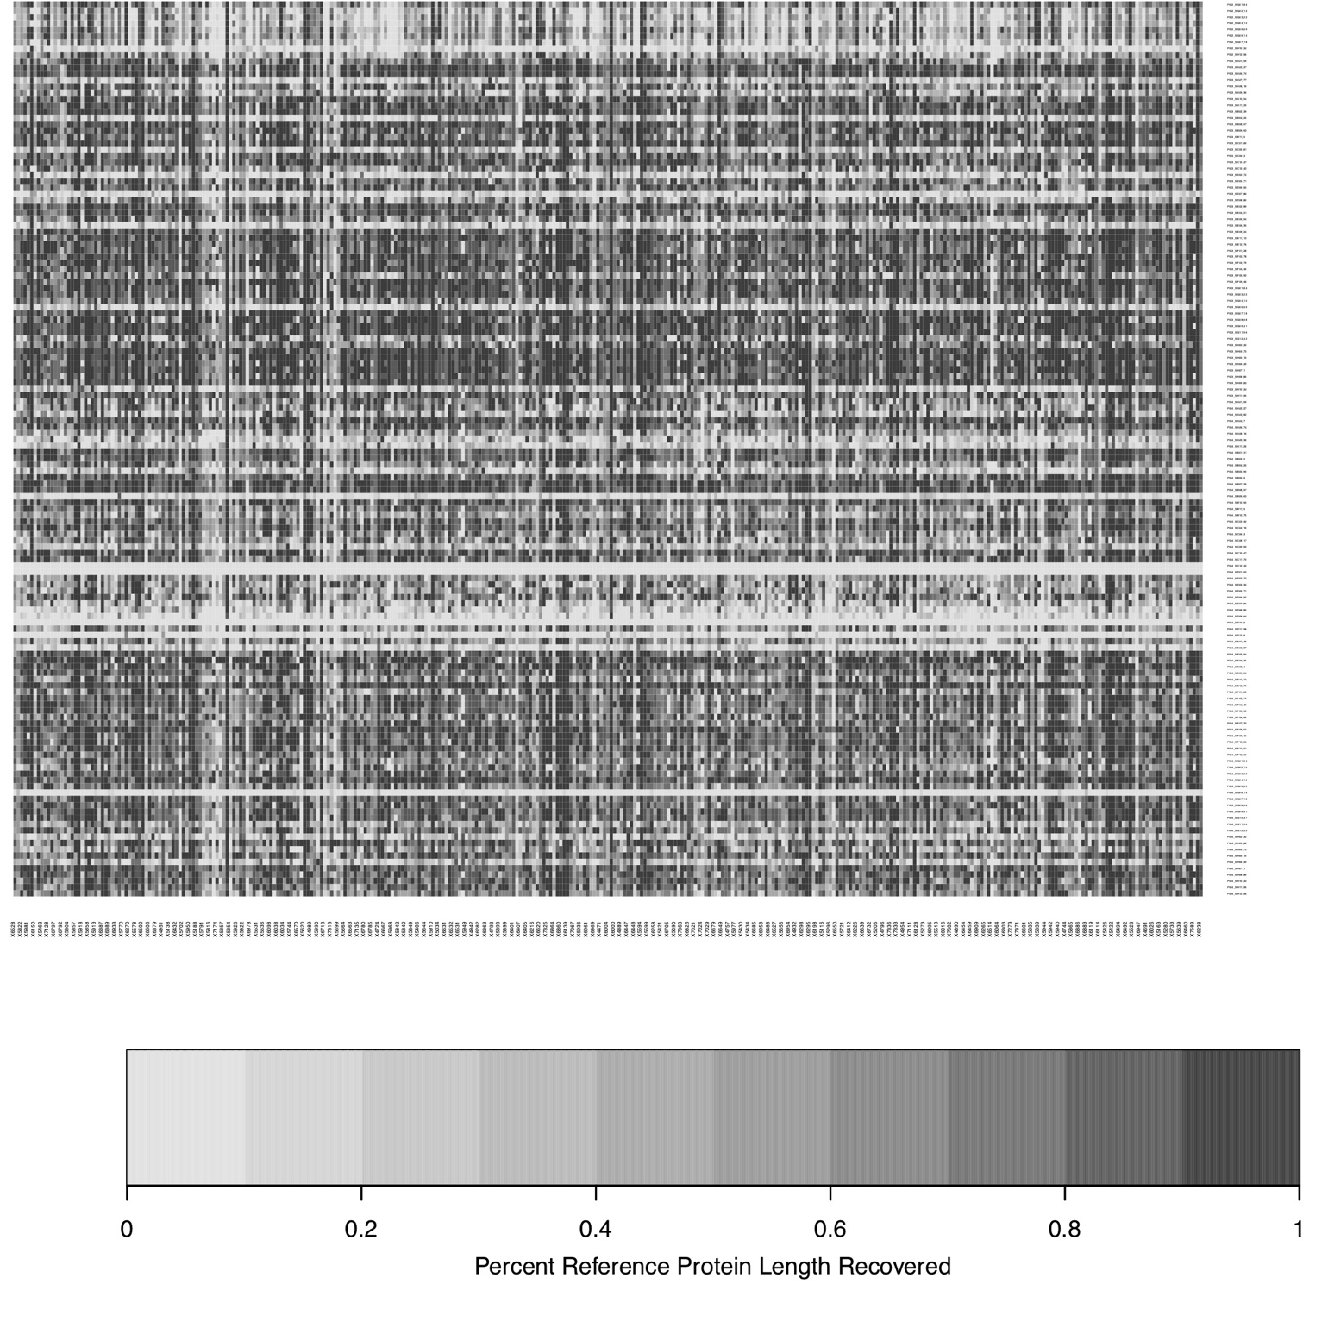
130 (Soltis)

Slide 31
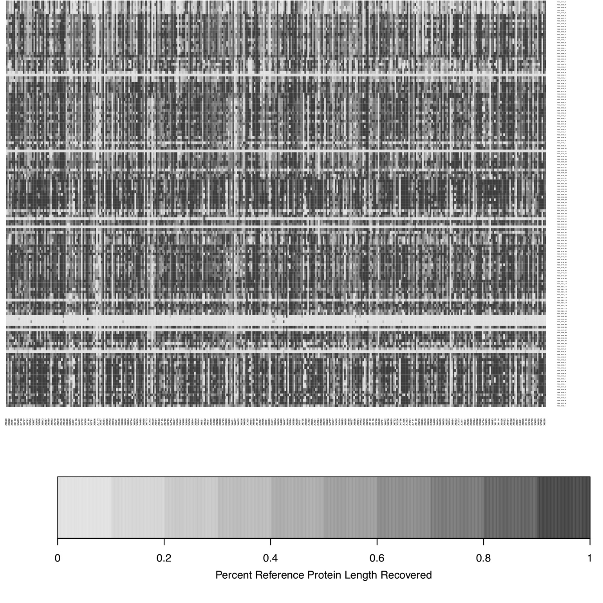
150(ZYP)

Slide 32
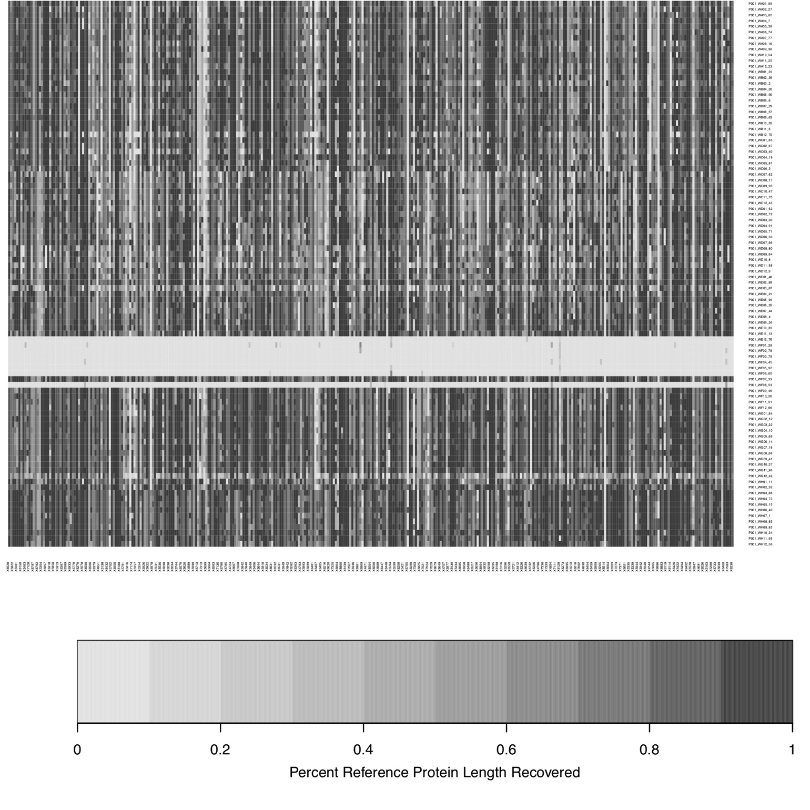
96 (Jenney)

Slide 33
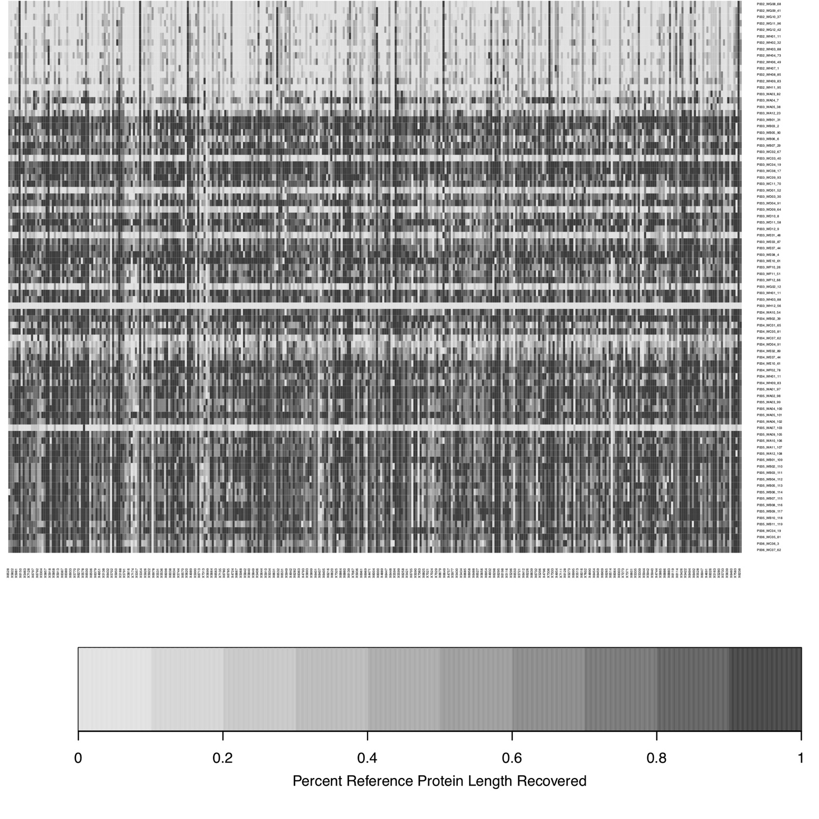
CZD (86)

Slide 34
Plans
Species list
Rerun PD analysis
Writing manuscript with Hanyang
Generate phylogeny (Exons data)
Exons only? Intron and exon flanking region? and paralogs? Other off target genomes (cp and mt), besides nuclear?

Slide 35
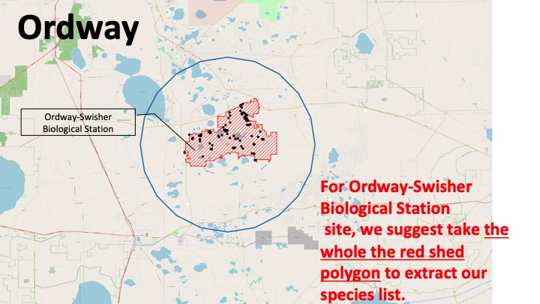
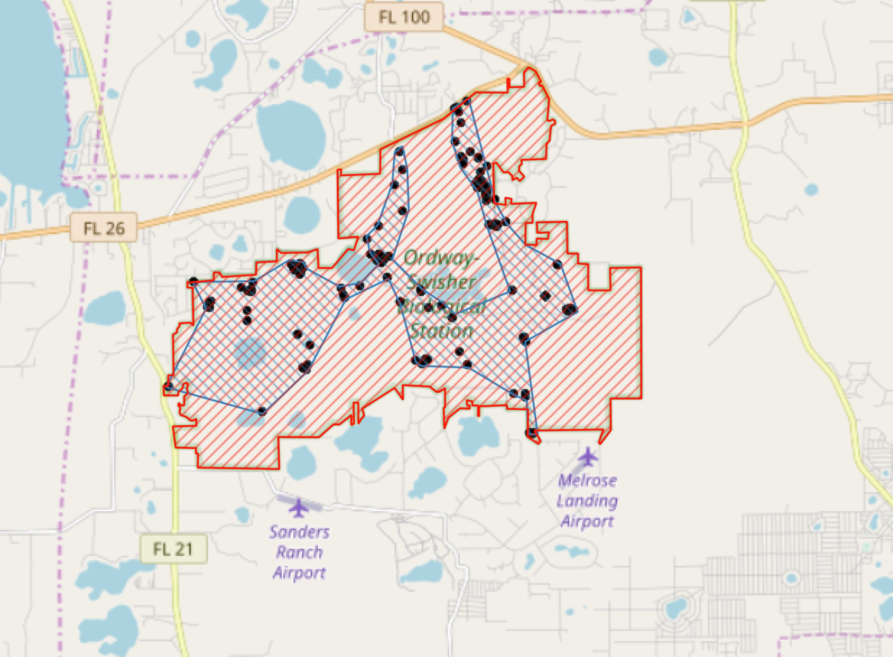

Slide 36
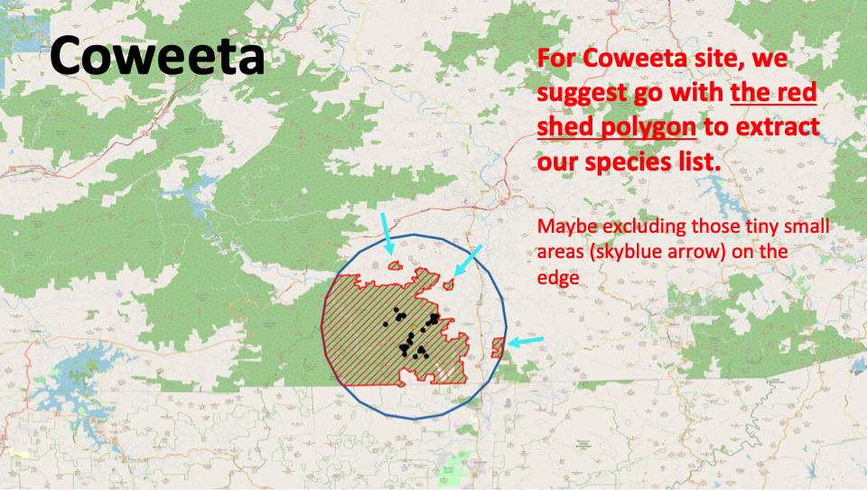
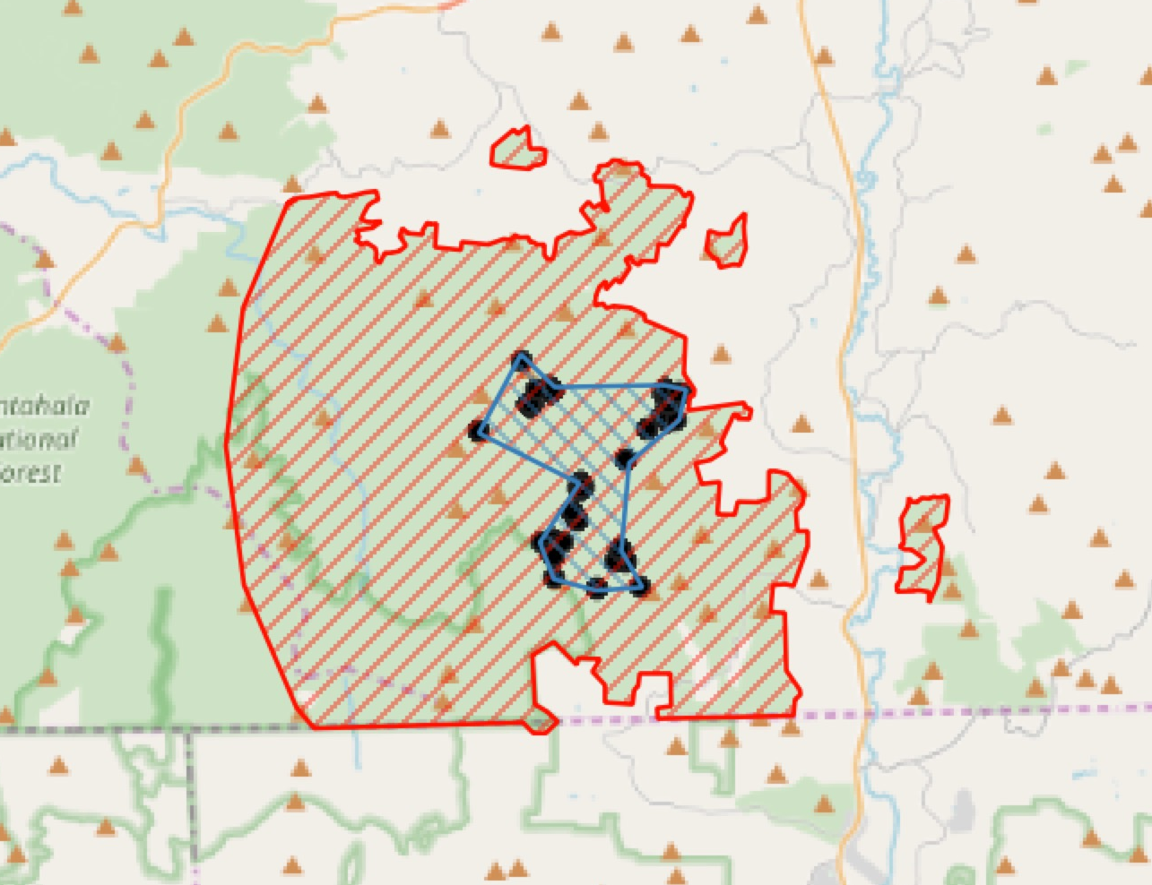

Slide 37
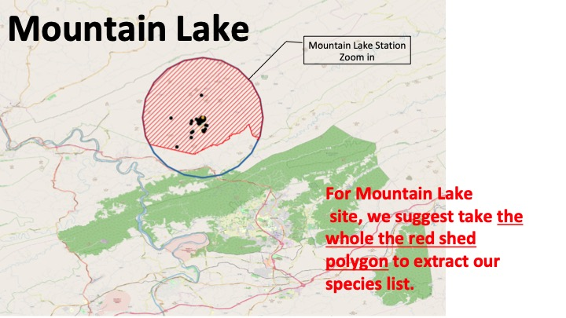
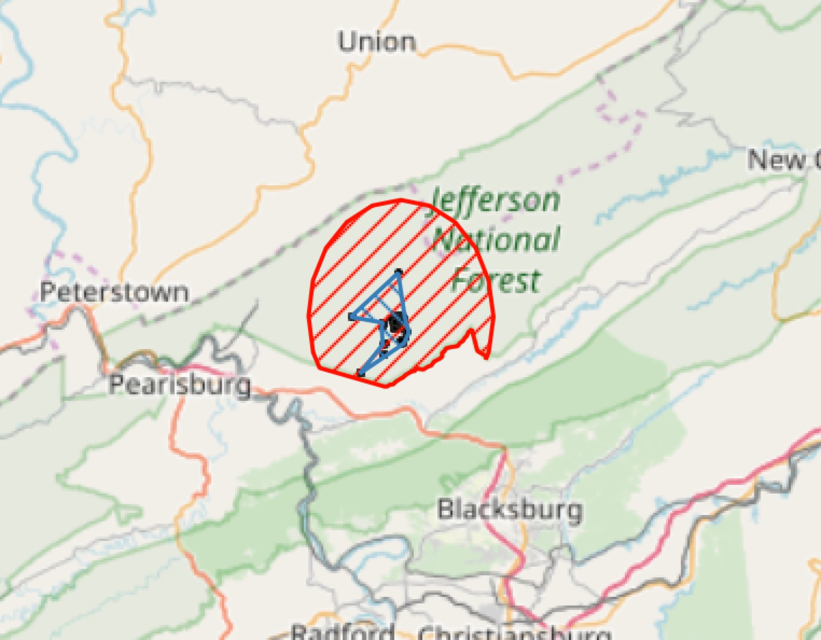

Slide 38
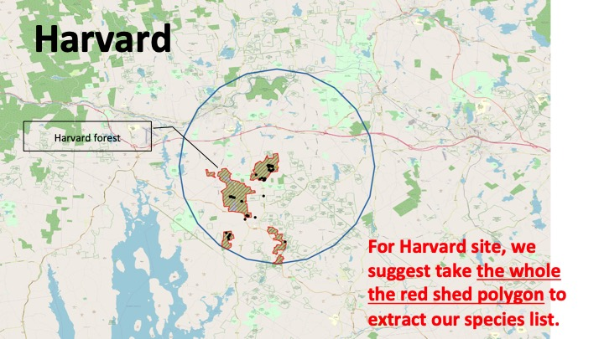
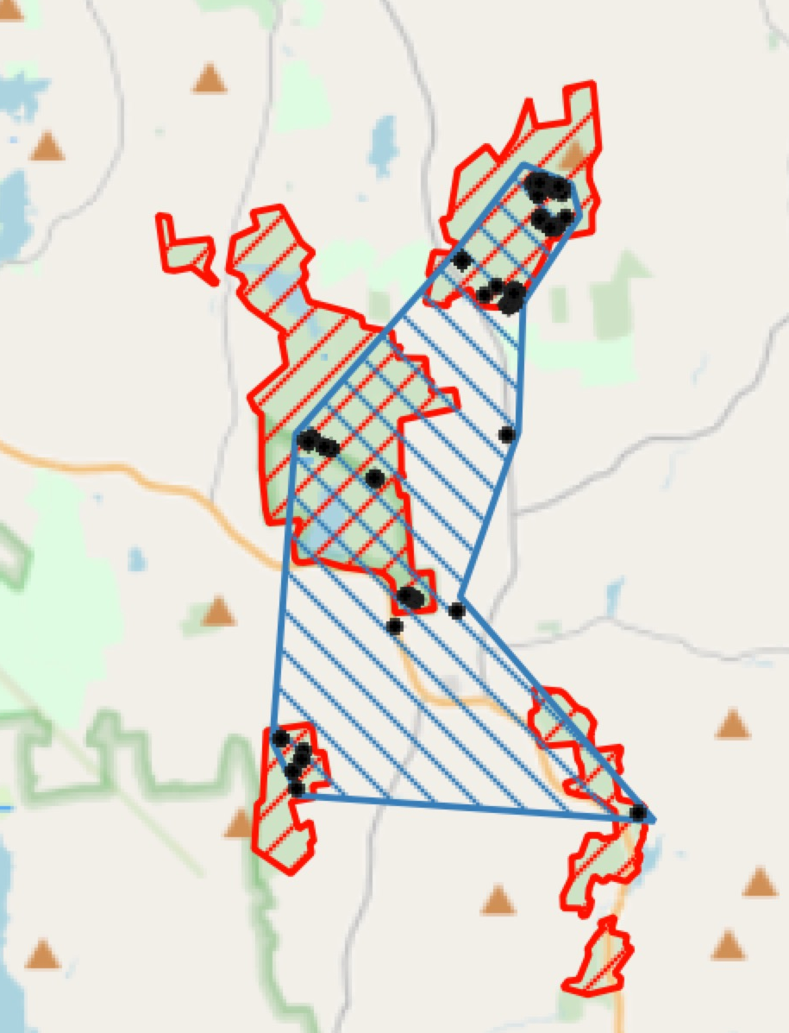

Slide 39
